Slide 1
A high speed addition method and logic for 4-bit addition

Slide 2
Presented By
Nasif Wasek Fahim
ID: 2017-1-60-037
Priyanka Mondal Piya
ID: 2017-1-60-038
Md. Jubayer Hossain Abir
ID: 2017-1-60-084

Slide 3
Normal 4-bit additional method
A 4-bit ripple-carry adder :
A ripple carry adder is simple, which allows for fast design time; however, the ripple-carry adder is relatively slow, since each full adder must wait for the carry-bit to be calculated from the previous full adder.

Slide 4
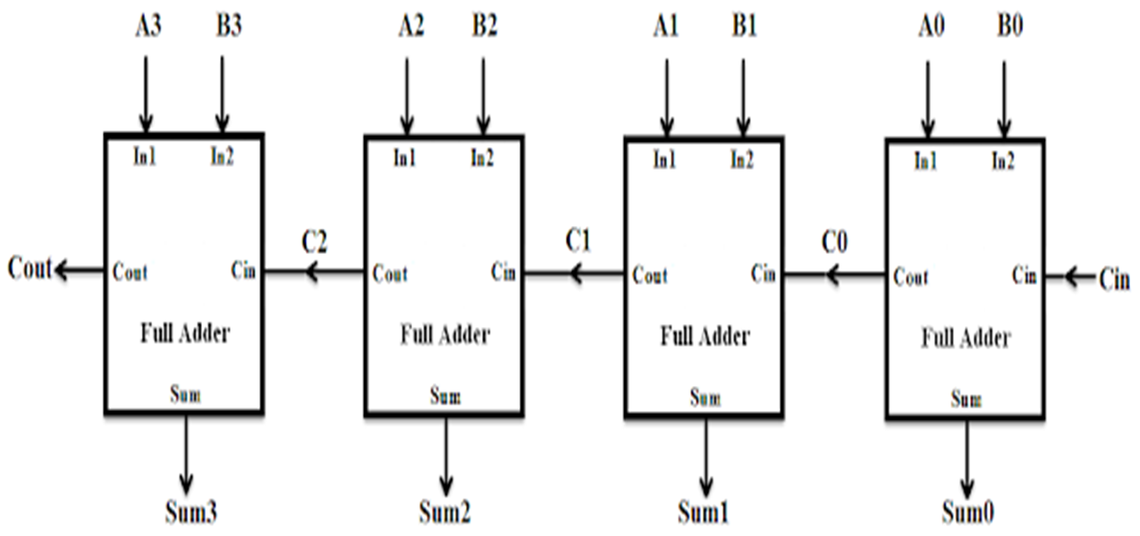
Block diagram

Slide 5
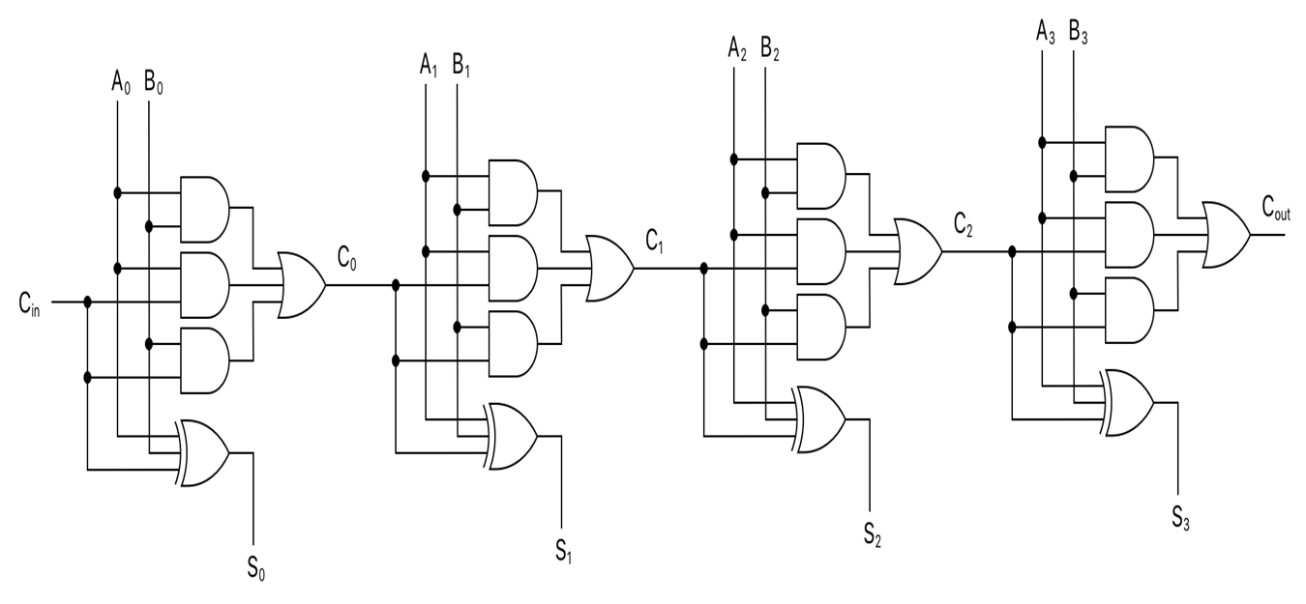
Circuit diagram

Slide 6
Verilog code
module ripple_carry_adder (Cin,A,B,S,Cout);
parameter n=4;
input Cin;
input [n-1:0] A,B;
output reg [n-1:0] S;
output reg Cout;
reg[n:0] C;
integer k;
always@ (Cin,A,B)
begin
C[0]=Cin;
for(k=0; k<=n-1; k=k+1)
begin
S[k]= A[k]^B[k]^C[k];
C[k+1]= (A[k] & B[k]) | (A[k] & C[k]) | (B[k] & C[k]);
end
Cout= C[k];
end
endmodule

Slide 7
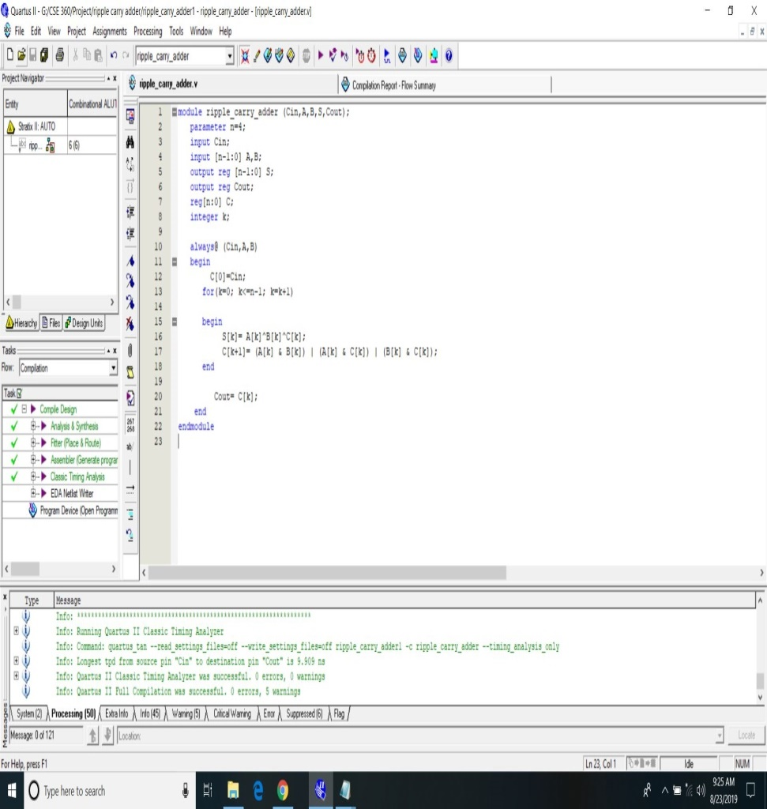
Verilog Code Continues

Slide 8
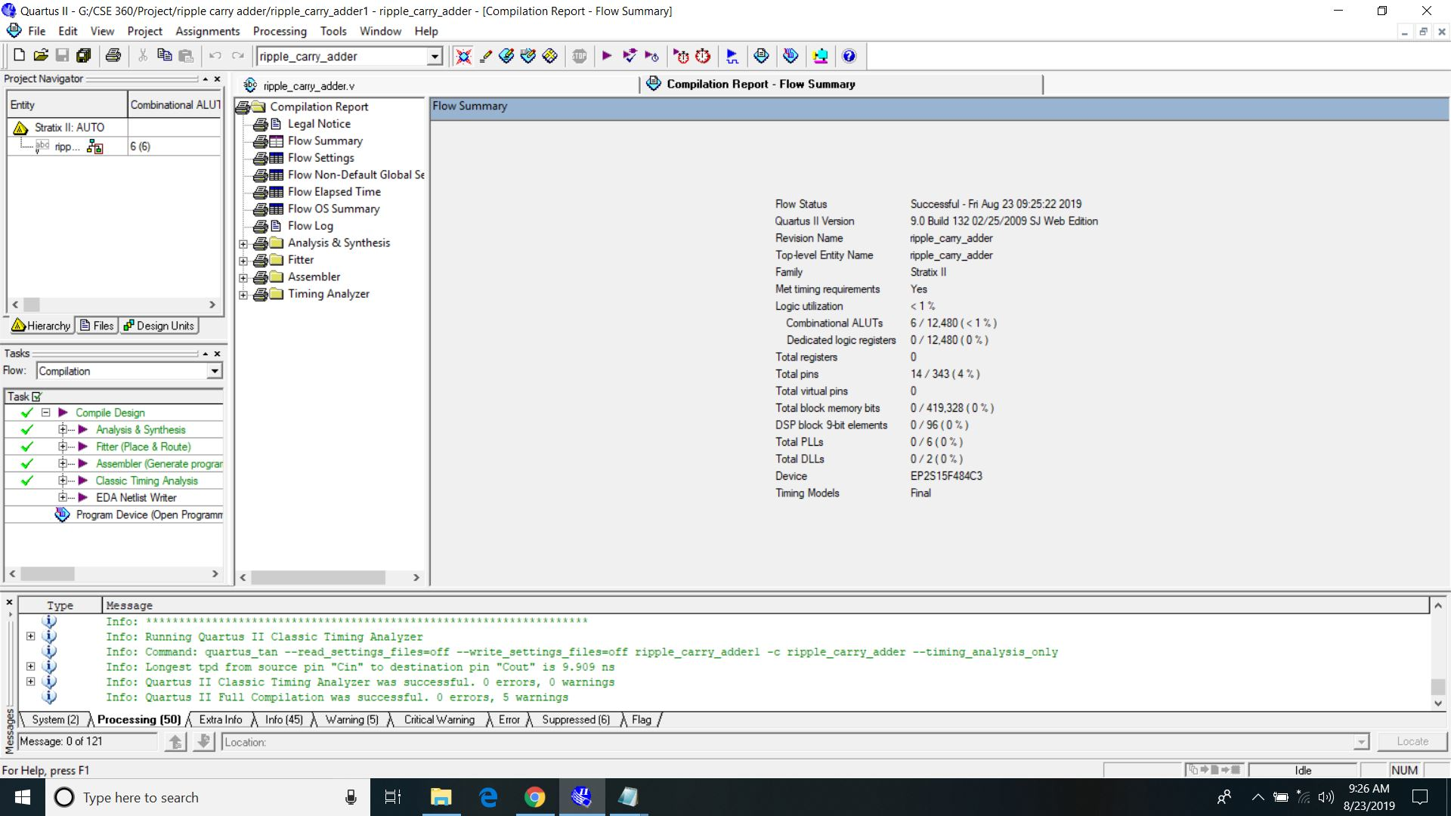
Compilation report

Slide 9
High speed addition method
4-bit carry look ahead adder
Carry look ahead is a digital circuit used for determining the carry bits used by the adder for addition without the wait for the carry propagation. It generates the carry bits for all the stages of the addition at the same time as soon as the input signal (Augend, addend, carry in) is provided.

Slide 10
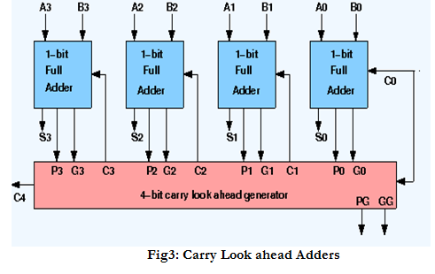
Block diagram

Slide 11
Circuit diagram

Slide 12
Verilog code
module carry_lookahead_adder (Cin,A,B,S,C);
parameter n=4;
input Cin;
input [n-1:0] A,B;
output [n-1:0] S;
output [n-1:0] C;
reg [n-1:0] G;
reg [n-1:0] P;
integer k;
always@ (A,B)
begin
for(k=0; k<=n-1; k=k+1)
begin
G[k]= (A[k]&B[k]);
P[k]= (A[k]^B[k]);
end
end
assign C[0]= G[0] | (P[0] & Cin);
assign C[1]= G[1] | (P[1] & G[0]) | (P[1] & P[0] & Cin);
assign C[2]= G[2] | (P[2] & G[1]) | (P[2] & P[1] & G[0]) | (P[2] & P[1] & P[0] & Cin);
assign C[3]= G[3] | (P[3] & G[2]) | (P[3] & P[2] & G[1]) | (P[3] & P[2] & P[1] & G[0]) | (P[3] & P[2] & P[1] & P[0] & Cin);
assign S[0]= A[0]^B[0]^C[0];
assign S[1]= A[1]^B[1]^C[1];
assign S[2]= A[2]^B[2]^C[2];
assign S[3]= A[3]^B[3]^C[3];
endmodule

Slide 13
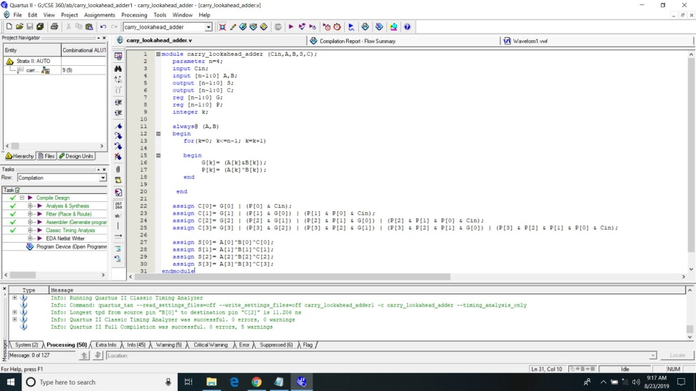
Verilog Code Continues

Slide 14

Compilation report

Slide 15
Key Differences
Design Efficiency
Calculation and Carry Propagation
Waiting Mechanism
Circuit Delay

Slide 16
Advantages
Carry look ahead circuit is a digital circuit.
This circuit significantly improves speed, and reduces delays in the circuit.
A 4-bit carry look ahead adder is 3 times faster from a 4-bit ripple carry adder.

Slide 17
Conclusion
As we have discussed in the ripple carry adder that the adder takes a time delay to compute sum because the carry was propagated through all the gates from input to output.
To increase the speed of the addition we need to provide the carry bits used by these adders without the wait for the preceding additions is known as Carry look ahead logic.

Slide 18
Thank You!
Any Questions?

